Slide 1
X EDUCATION CASE STUDY IDENTIFICATION OF HOT LEADS – USING LOGISTIC REGRESSION
BY –Deepika bhatt

Slide 2
PROBLEM STATEMENT
Current conversion Rate is around 30%
Assign lead score to each lead
Find most potential leads (using assigned lead score)
Social Media Marketing
Initial Pool Lead
Lead Nurturing (Hot Lead)
Converted Lead

Slide 3
DESCRIPTION OF DATA
Shape
DATA CLEANING
Checking Null values
EDA
Univariate Analysis of all the variables (categorical variable- Bar plot, continuous variable- boxplot)
Info
Data Type
Statistical Summary of Data
Bivariate Analysis to find the correlation between variables by plotting Heat Map
Null value Treatment
Dropping columns which are not useful for further analysis
DATA PREPARATION
Outliers Treatment
Formatting data for the model building process by converting binary variable into 0 and 1
Creating dummy variable
MODEL BUILDING
Splitting data into train dataset and test dataset
Feature scaling
MODEL EVALUATION & VALIDATION
Coarse tunning – Automated approach of feature elimination (RFE)
Fine tunning – Manual approach of feature selection (by observing p value and VIF)
Accuracy
Sensitivity
Specificity
Precision & Recall
Validating the model using Test data set
APPROACH & METHODOLOGY

Slide 4
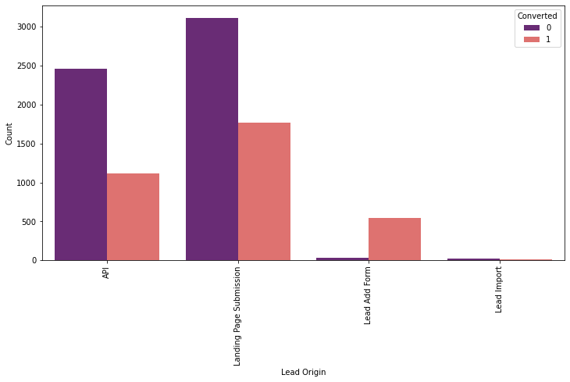
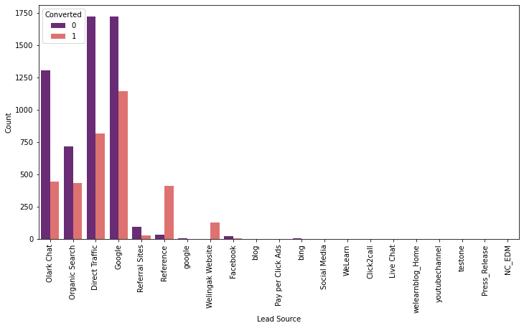
UNIVARIATE ANALYSIS – CATEGORICAL VARIABLE
The count of lead originating from 'API' and 'Landing Page Submission' are very significant and have around 30% conversion rate.
'Lead Add Form' has a very high conversion rate(around 90%) but the count of lead is very low.
The lead source is mostly from 'Google' followed by 'Direct traffic' but their conversion rate is pretty low. -'Reference' and 'welingak website' have a very high conversion rate but the number of leads generated is very low.

Slide 5
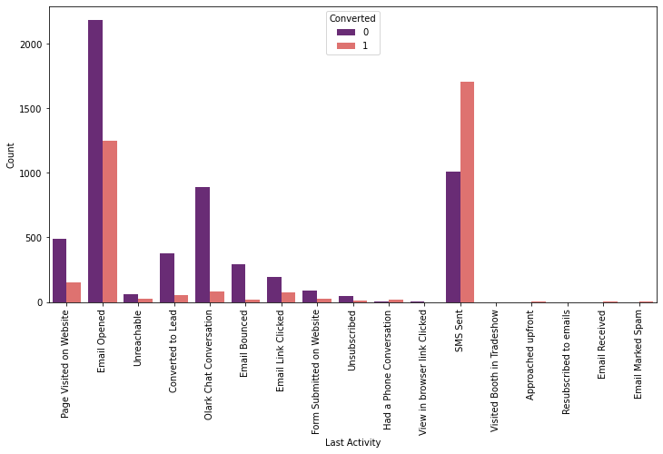
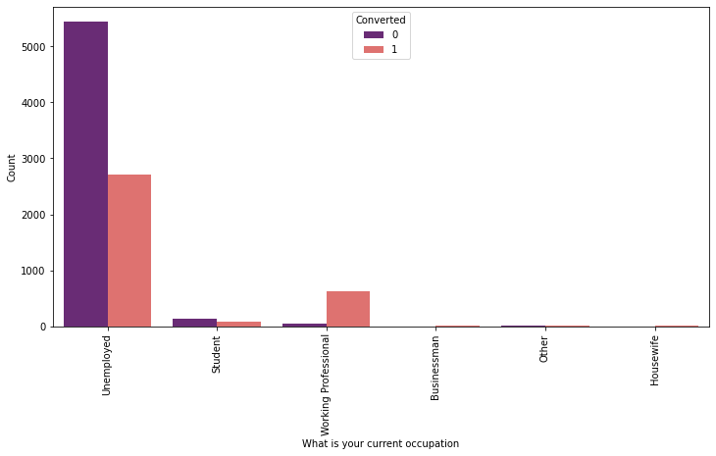
UNIVARIATE ANALYSIS – CATEGORICAL VARIABLE
Most of the leads last activity is 'Email Opened' followed by 'SMS Sent'. The conversion rate is pretty good for SMS sent category.
Most of the leads are unemployed and they do not have a good conversion rate. Working professionals have a very good conversion rate but the number of leads is pretty low.

Slide 6
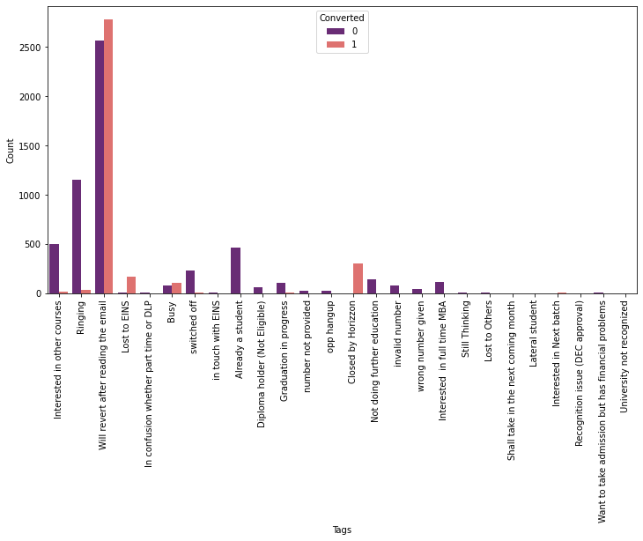
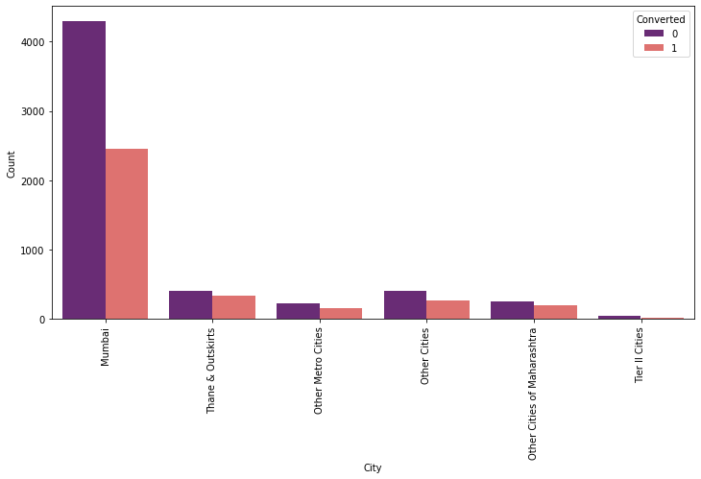
UNIVARIATE ANALYSIS – CATEGORICAL VARIABLE
Leads who are tagged as 'Will revert after reading email' have a good conversion rate and the number of leads are high as well.
It is clearly evident that most of the leads are from Mumbai and they have around 30% conversion rate.
TAG

Slide 7
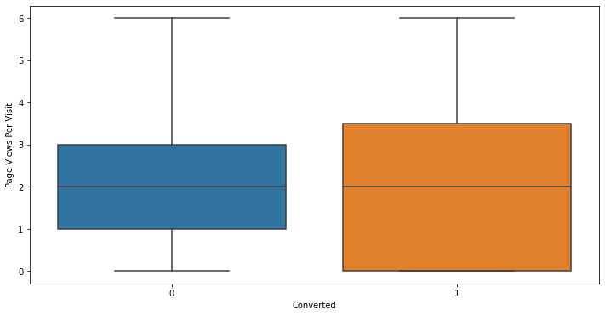
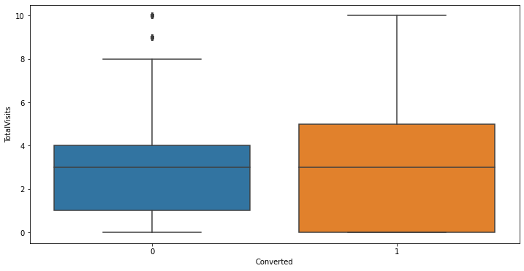
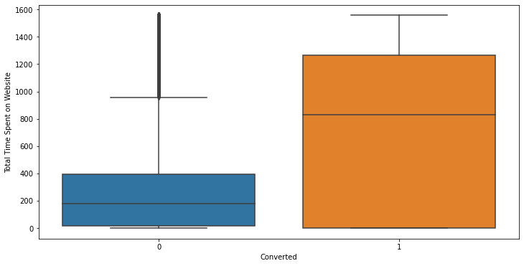
UNIVARIATE ANALYSIS – CONTINIOUS VARIABLE
The median value of total visits is similar for both converted and non converted leads
The leads who are converted spent more time on the website as we can see a big increase in the median and IQR for the converted leads

Slide 8
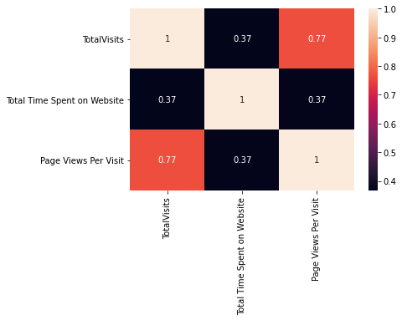
BIVARIATE ANALYSIS – CONTINIOUS VARIABLE
From Heat map we can observe that variable "Total visits" is highly positively correlated with "page Views Per Visit" with correlation coefficient of 0.77.

Slide 9
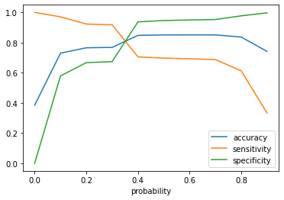
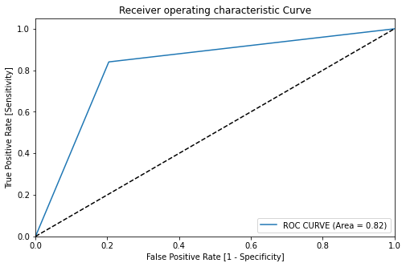
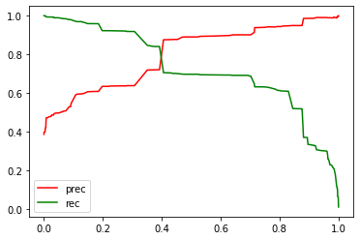
FINAL MODEL PARAMETERS
Logistic Regression Final Model Parameters
ROC Curve area = 0.82
With the help of accuracy , sensitivity and specificity we have finalized the cut off point as 0.385
We can observe from precision and recall curve also that we are getting cut off point around 0.385

Slide 10
MODEL EVALUATION
Model Evaluation | Train Data | Test Data
Accuracy | 0.81 | 0.81
Sensitivity | 0.84 | 0.81
Specificity | 0.79 | 0.80
Precision | 0.72 | 0.70
Recall | 0.84 | 0.81
Our Logistic Regression Model is accurate and decent enough with high sensitivity as required. Since CEO in particular, has given a ballpark of the target lead conversion rate to be around 80%.
The values in the table shows that model is performing well on the test data set and is not over-trained.

Slide 11
CONCLUSION
The Education company needs to focus on the following factors in order to improve the conversion rate of leads.
The leads who are tagged as 'Closed By Horizon' have a very high conversion rate.
The leads who are tagged as 'Will revert after reading email' have a good conversion rate and the number of customers tagged to this are very high and therefore these leads need to be focused more.
The leads with lead source 'Welingak website' have a high conversion rate.
The leads with Last notable activity 'SMS sent' have a high conversion rate.
The total time spent on the Website has an impact on the conversion rate.
Leads who are working professionals have a high conversion rate.

Slide 12
THANK YOU

